Slide 1

Capstone Project: Opening a Bubble Waffle stand in London, UK
Roberto Villalobos
February 2021

Slide 2
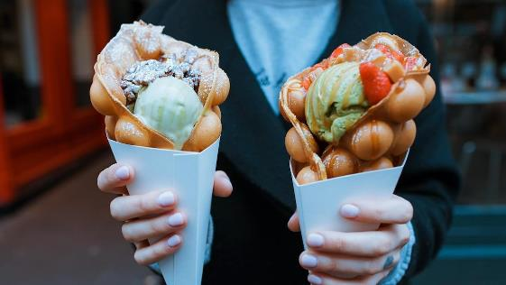
Introduction
This project will focus in the business case of opening a street food stand serving Bubble Waffle and hot drinks in the city of London, United Kingdom.
One of the most populated cities in the world and famous for street markets
What is the best spot in the city to open this stand and maximise both local population and daily visitors?

Slide 3

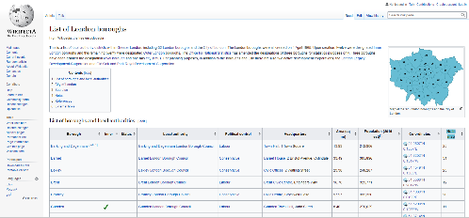
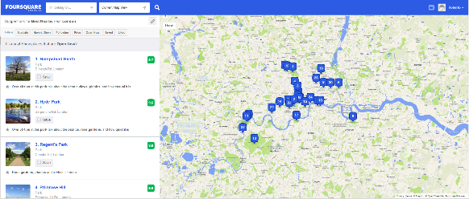

Data
London boroughs’ population and location extracted from Wikipedia’s website
Foursquare data to explore and analyse the venues in each of the boroughs, looking at the most common type of venues by category

Slide 4
Methodology
Data scrapping: I will get my Borough’s population, area and coordinates from Wikipedia, scrapping one of the tables.
I will use Foursquare in order to find the main places of interest per Borough and will merge this data with the previous table.
I will divide my data into 3 clusters using K-means methodology.
I will display the clusters in a map generated using folium’s library.

Slide 5
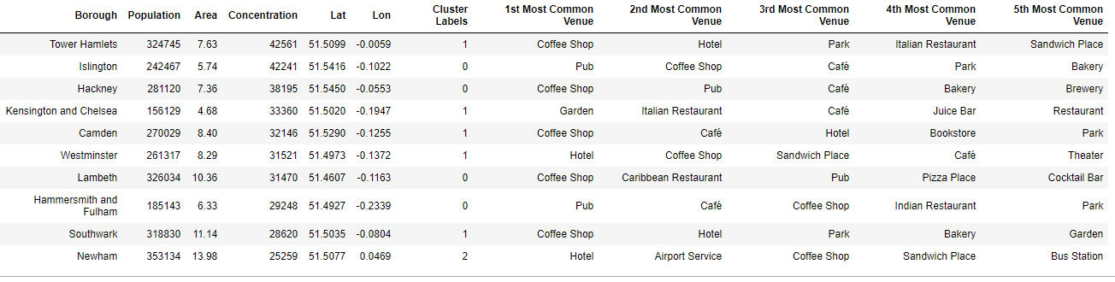
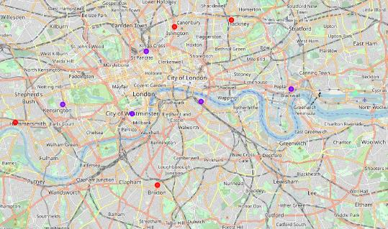
Results
After splitting the boroughs into 3 clusters in order to classify them by their most common venues, we end up with he following distribution:
If we locate the boroughs in a map and colour them depending on the cluster they belong to, we see Cluster 1 (purple) is distributed around the city center, while Cluster 0 is located in the outskirts of the city.

Slide 6
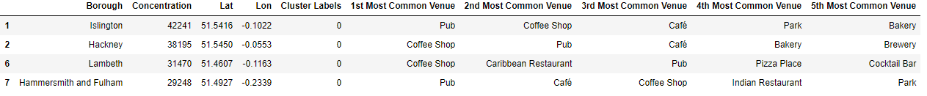
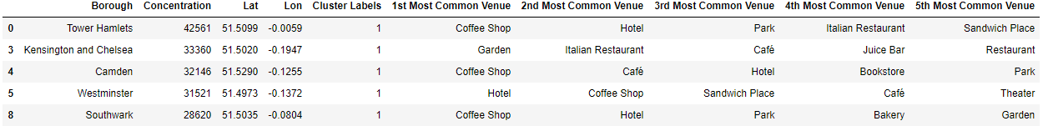
Results
Cluster 0: This cluster main characteristic is all boroughs have pubs in top-3 positions, indicating these activity is focused on going out and having some drinks and food (pubs, restaurants, cafes).
Cluster 1:The main difference in this cluster is the presence of Hotel in high positions (hint for tourism) and Park/Garden in most of the boroughs. These kinds of venues indicate tourist activity and other leisure activities such as walking and having take-aways (coffee, sandwich, Juice).
Cluster 2: We can clearly see Newham Borough is focused on the Airport and its services (Hotel, Airport, Bus Station), so we could say this area is not a destination for its points of interest in terms of tourism but rather an area to be close to the airport, with no major points of interest that indicate leisure activities that could drive bubble waffle sales.

Slide 7
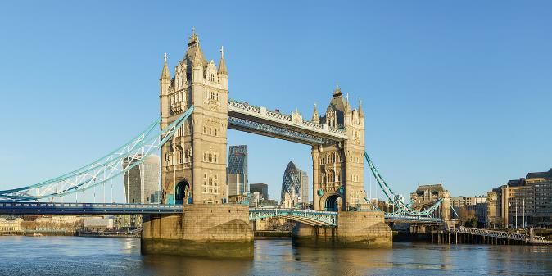
Recommendation
After taking into consideration our results and findings in the previous section of our project, I strongly recommend focusing on the boroughs in Cluster 1.
Within this cluster and considering the population concentration in the area in order to maximise both the population living in the area + visitors, I would recommend stablishing our Bubble Waffle stand in Tower Hamlets, where we can definitely benefit from must-sees in London such as Tower of London and Tower Bridge that attract millions of tourists every year.

Slide 8
Conclusion
This capstone project has allowed us to find the optimum borough to place our Bubble Waffle business in London: Tower Hamlets Borough.
We got to this conclusion by applying different techniques and methodologies studied across the courses offered by Coursera. Just to mention some of them, we have:
Used pandas, numpy, matplotlib, and folium libraries
Used Foursquare data in order to explore the venues in each borough
Scrapped data from the internet
Used K-means to split our data into clusters to help us in our decision
London is definitely one of the most visited places in Europe for its history and importance in Europe, attracting millions of tourists and visitors every year and making it a perfect city to stablish new businesses and to launch new projects.

